Slide 1

Governance, Compliance, and Risk in the SDLC Can Be a Fun Event!
Ryan Chambers
Technology Engineer
Jeremy Castle
Architecture Director
Notes:
Give overview of our Responsibilities
Jeremy – Director in Charge of DevOp Enablement. Working in the space for CI/CD for last 4.5 years. 15 Years of Developer Experience.
Kevin – Business Lines. Adopter of DevOp Practices.

Slide 2
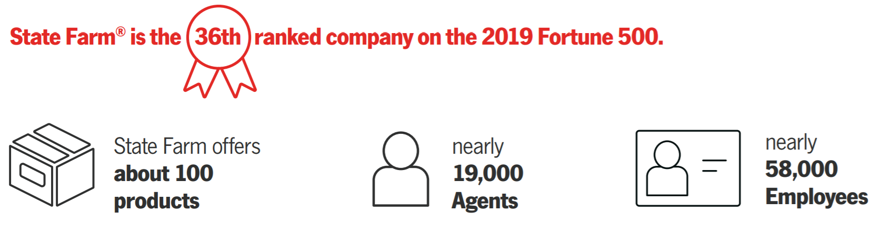
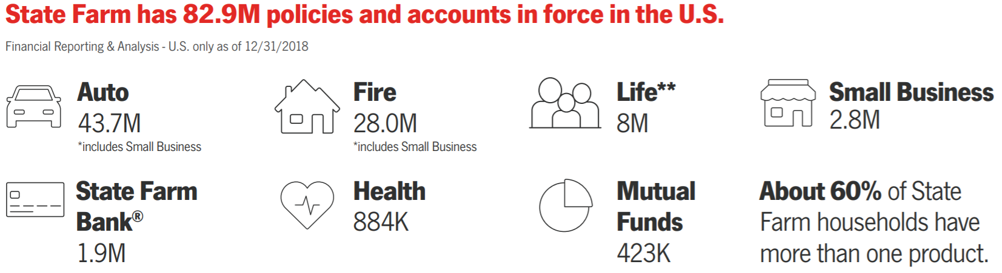
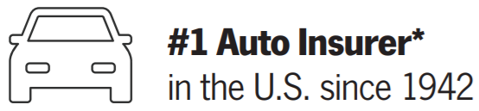
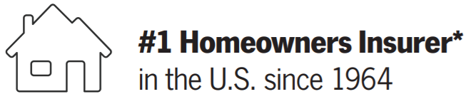
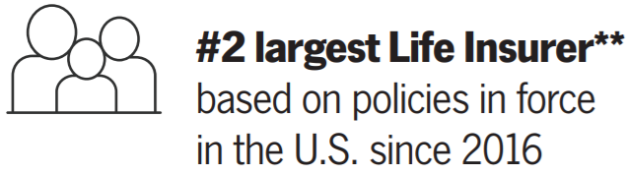
State Farm: Numbers Behind the Neighbors
Notes:
Kevin --- Give Overview of State Farm

Slide 3





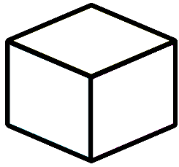

State Farm: Enterprise Technology
2900
software/infrastructure developers
7000 employees
100’s of Technologies from Java to Mainframe
15 Business Areas
in ET
2000+ Web Applications
1200 Product Teams
Notes:
This information came from HR Recruiting.
General purpose of this slide is to show the size and scope of State Farms ET. Requirement from the Conference.
Kevin and I are going to present our journey at State Farm. I primary responsibility for the enablement of our CI/CD practices and Kevin is a consumer of that enablement. Speak to our responsibilities.

Slide 4
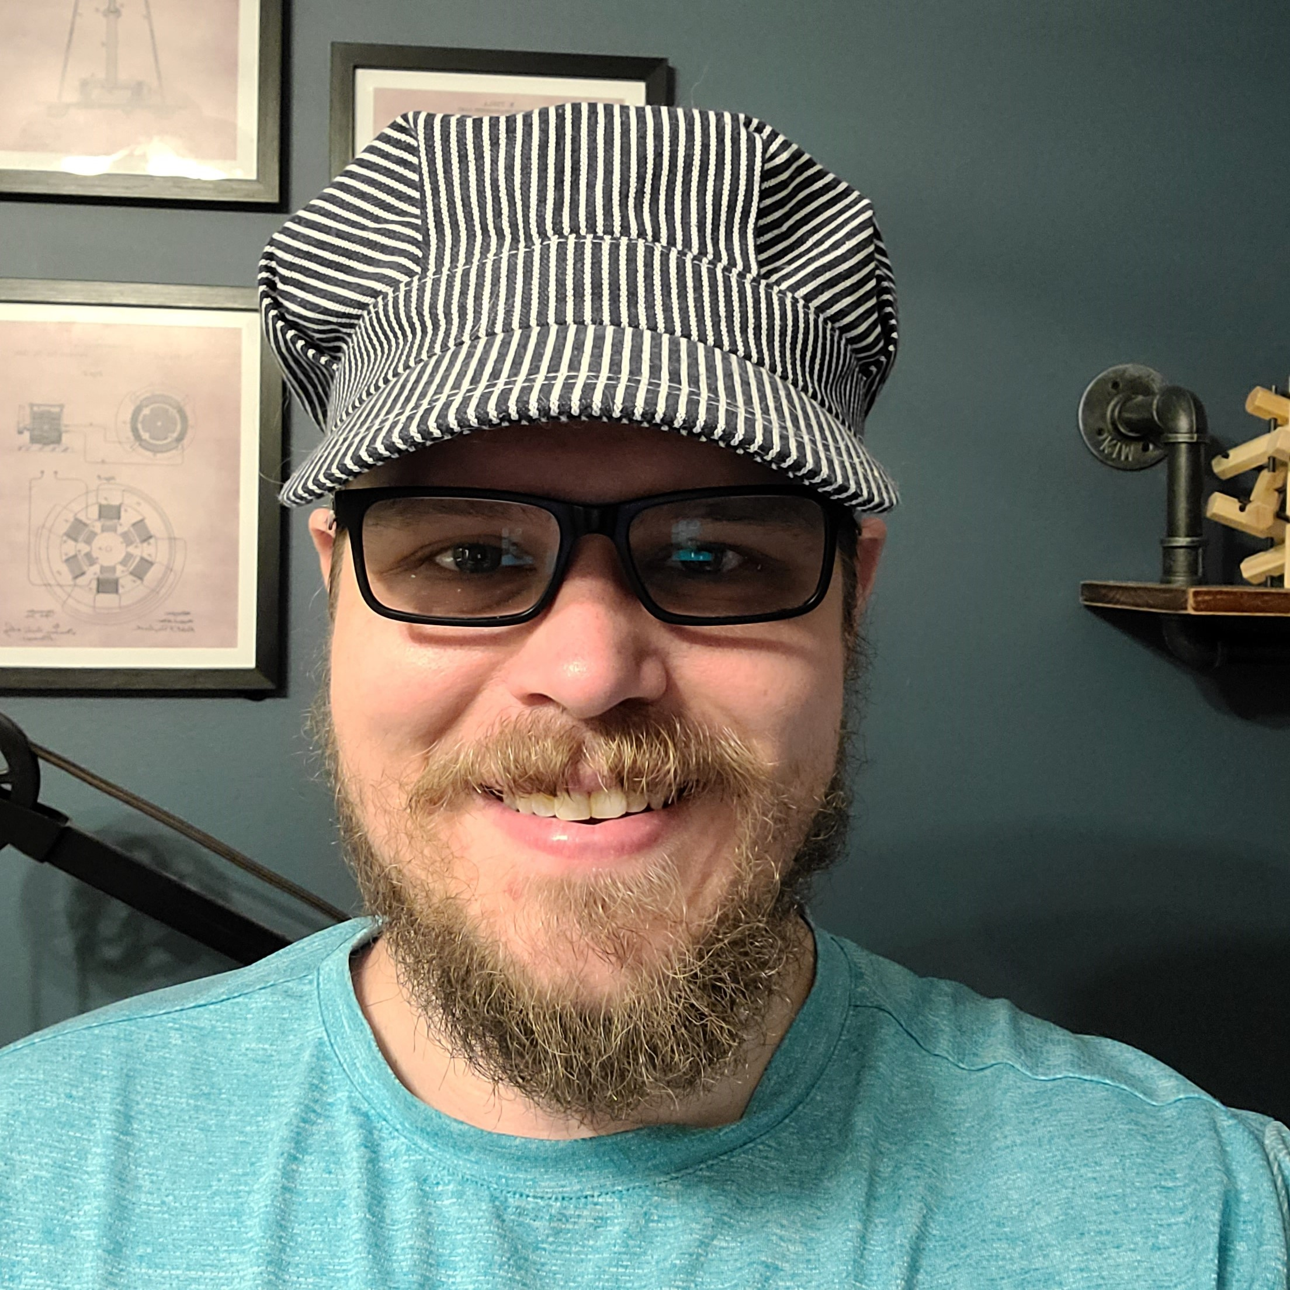
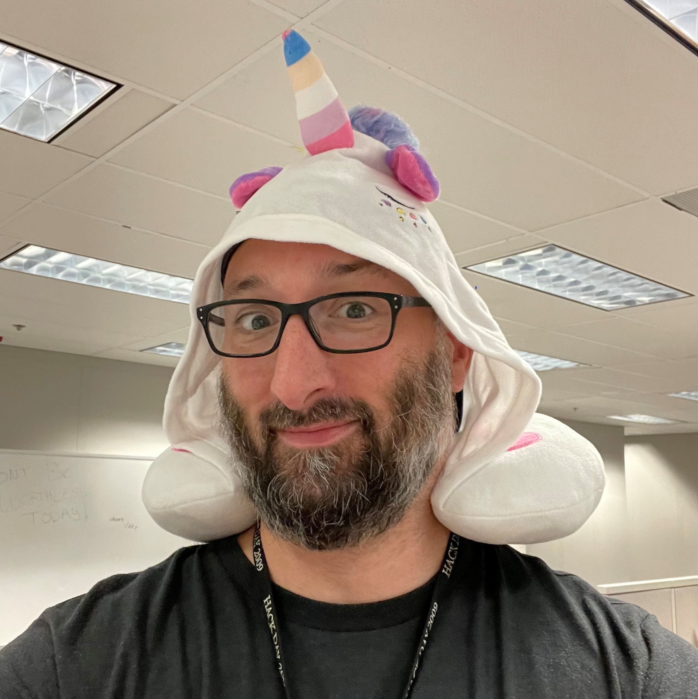
Where do we fit at State Farm?
Ryan Chambers
Where I Fit
Technology Manager
Resiliency Engineering
#SREambassador
Responsibilities
Enterprise SRE Practices and Enablement
#SREvangelist
Jeremy Castle
Where I Fit
Engineering Director
Horizontal Enablement for Enterprise Technology
Responsibilities
Application Development Lifecycle
Majority of Developer Tools and Experience
CI/CD Practices and Tools

Slide 5
THE Delivery Experience
Our mission is to provide one cohesive ecosystem of developer tools and services to improve the experience of our product teams in Enterprise Technology.

Slide 6
Where Do We Fit into State Farm?
The Delivery Experience
Business Area
Business Area
Business Area
We are a group of 60 that provides support for Developer Tools and Services
SCM, Pipelines, GitOps, Security Scanning Tools, Open Source, API’s, SDLC Best Practices

Slide 7
Does Your Developer Experience Look Like This?
CAB Gates used for Governance of the SDLC
Proof of Testing is Manual
No Visibility into Potential Bottlenecks in the SDLC
Myriad of Tools/Platforms to Manage a Change

Slide 8
A Feature is Like a Shopping List
Did you Commit your Code?
Did you Run your Security Scan?
Did you Unit Test?
Did you Deploy to a Test Environment?
Was the Code Reviewed?

Slide 9
The Cashier
You crave that small talk and want to have some human interaction, so you get into line and wait for your turn to load up your groceries on that conveyer belt and have a cashier ring you up. The cashier rings you up, you pay for your stuff, and you head home.
This process took longer. You had to stand in line, you had to talk to a person, and you had to wait for them to ring you up.

Slide 10
Self Checkout
You aren’t really in the talking mood and want to get home. There is a line waiting for that cashier, but the self checkout stations are freeing up quickly. So, you head over there and ring up your items. Sure, there isn’t a trained person ringing your stuff up, so it makes a little more work for you, but you are able to get through it quickly.
This process ends up being a bit quicker. You don’t have to stand in line, and you are able to ring your stuff up just as easily as another person can.

Slide 11
Grab and Go
You simply scan the app as you walk in the store, grab your stuff, and leave.
No lines, no awkward conversations, no ringing up items. You go into the store to accomplish your goal of picking up some food and leave.

Slide 12
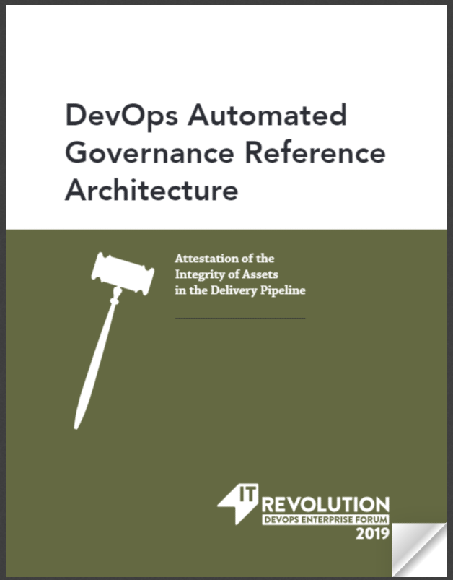
We Have a Theory…
What if our developer tools self reported important actions and we built governance around those events?

Slide 13
Our Architectural Principles….
Don’t Mind Us, We Are Just Listening In
Our Tools and Systems should self report when important Events happen, and people shouldn’t have to know it’s even happening.
Social Distance Systems
Events should NOT be coupled to a process or system. Anyone can react to an event and we shouldn’t care.
You Can Run, But You Cannot Hide
Events should be tied a code change and be transparent for the life cycle of that code change.
Go - Go Gadget
Our Eventing system should be scalable based on demand of our developer community.
Robot Insurance
Eliminate any need for manual controls by providing API’s and CLI’s for scripting to mimic what a human might do.

Slide 14
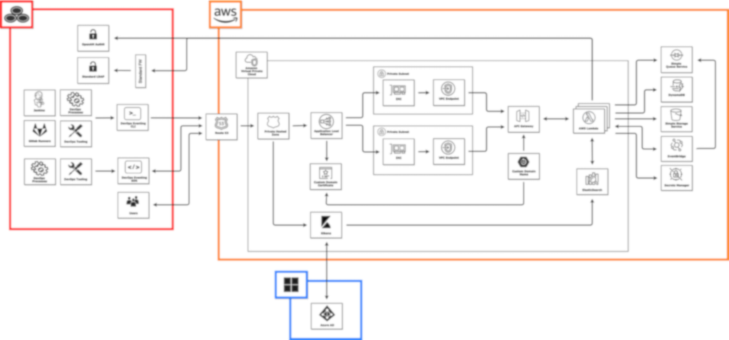
Let’s Make Everything an Event!

Slide 15
Our Shopping Cart is Now Full
GitOps
Foundation for automating change
EOT Repository
Object Storage Based Repo for Test Artifacts
DevOps Eventing
Pub/Sub Eventing Framework
Events
Webhooks or CLI’s around our Developer/Pipeline Tools

Slide 16
Test Our Theory
Who is Running Scans Before Production?

Slide 17
What Does the Future Hold?
Transparency of Changes in an Environment
Automated Governance of the SDLC
Analysis of Code Changes in almost real time
Analytics for Quality of Change

Slide 18
Thank you.
Ryan @
ryan.chambers.rse9@statefarm.com
Jeremy @ jeremy.castle.lvh0@statefarm.com

Slide 19
Here to help life go right.®

